Slide 1

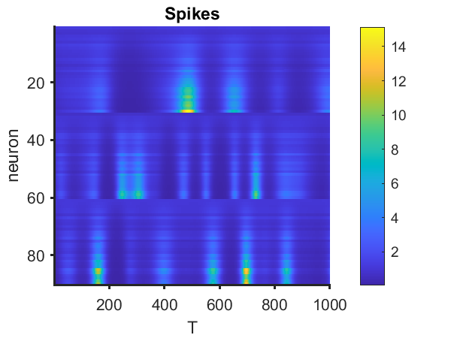
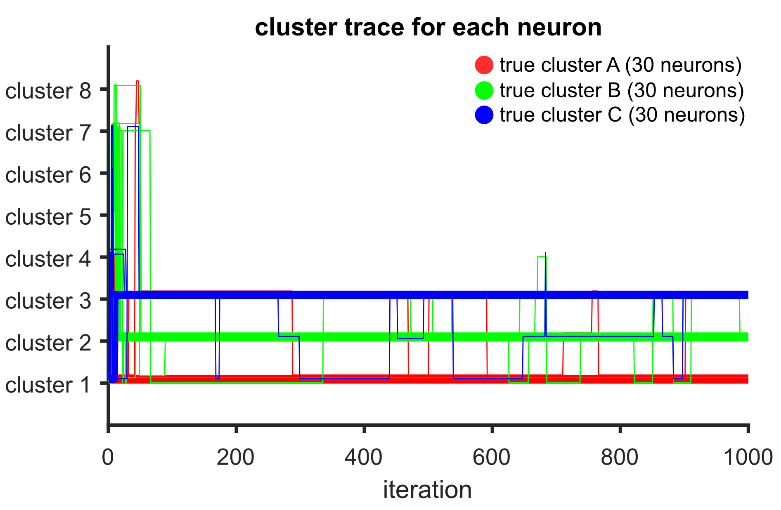
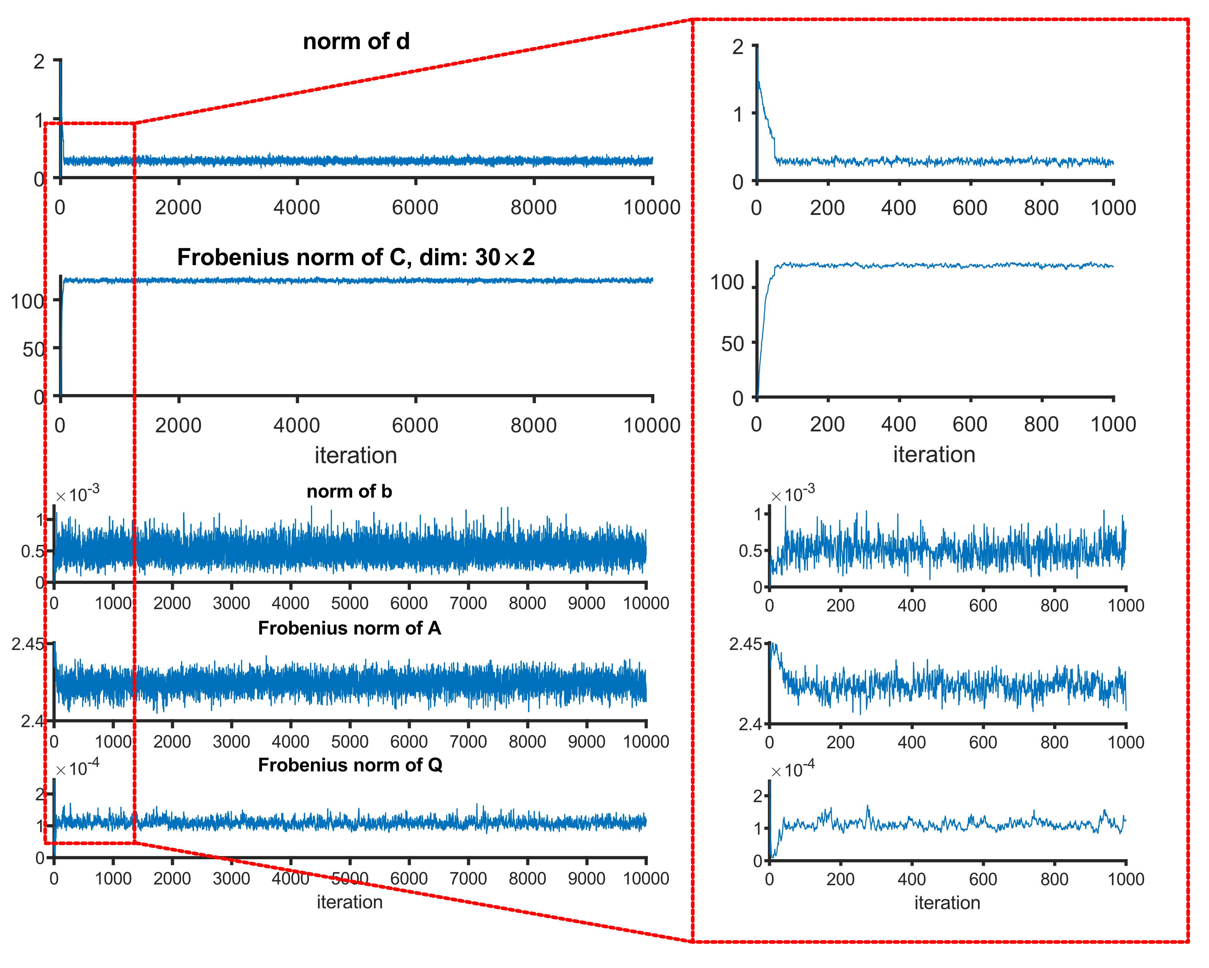
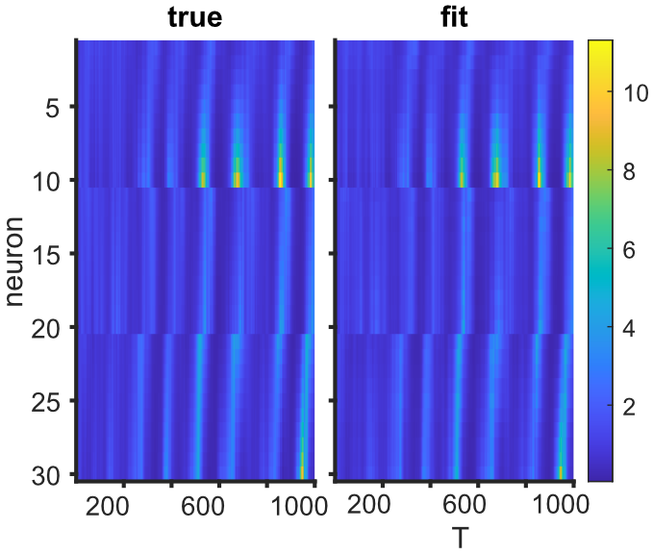
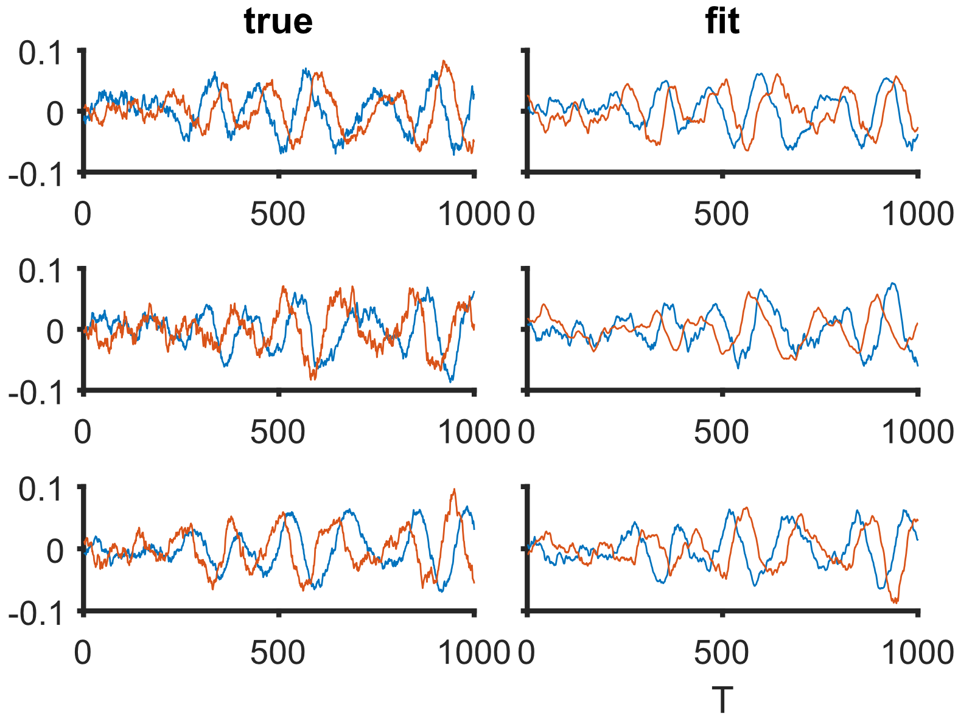
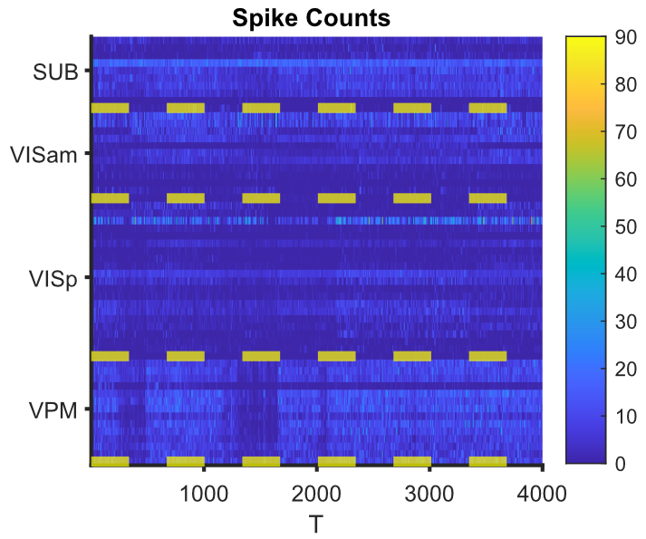
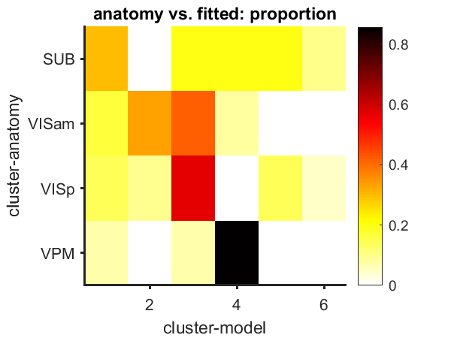
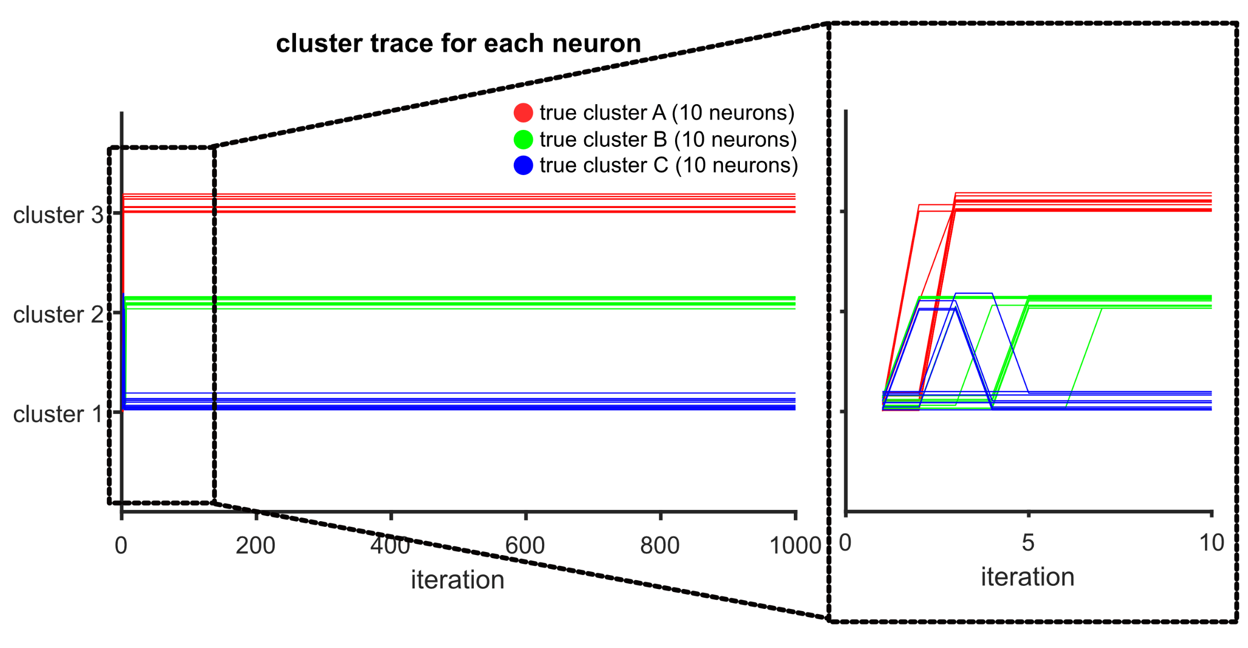
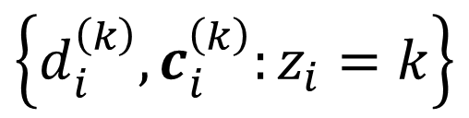
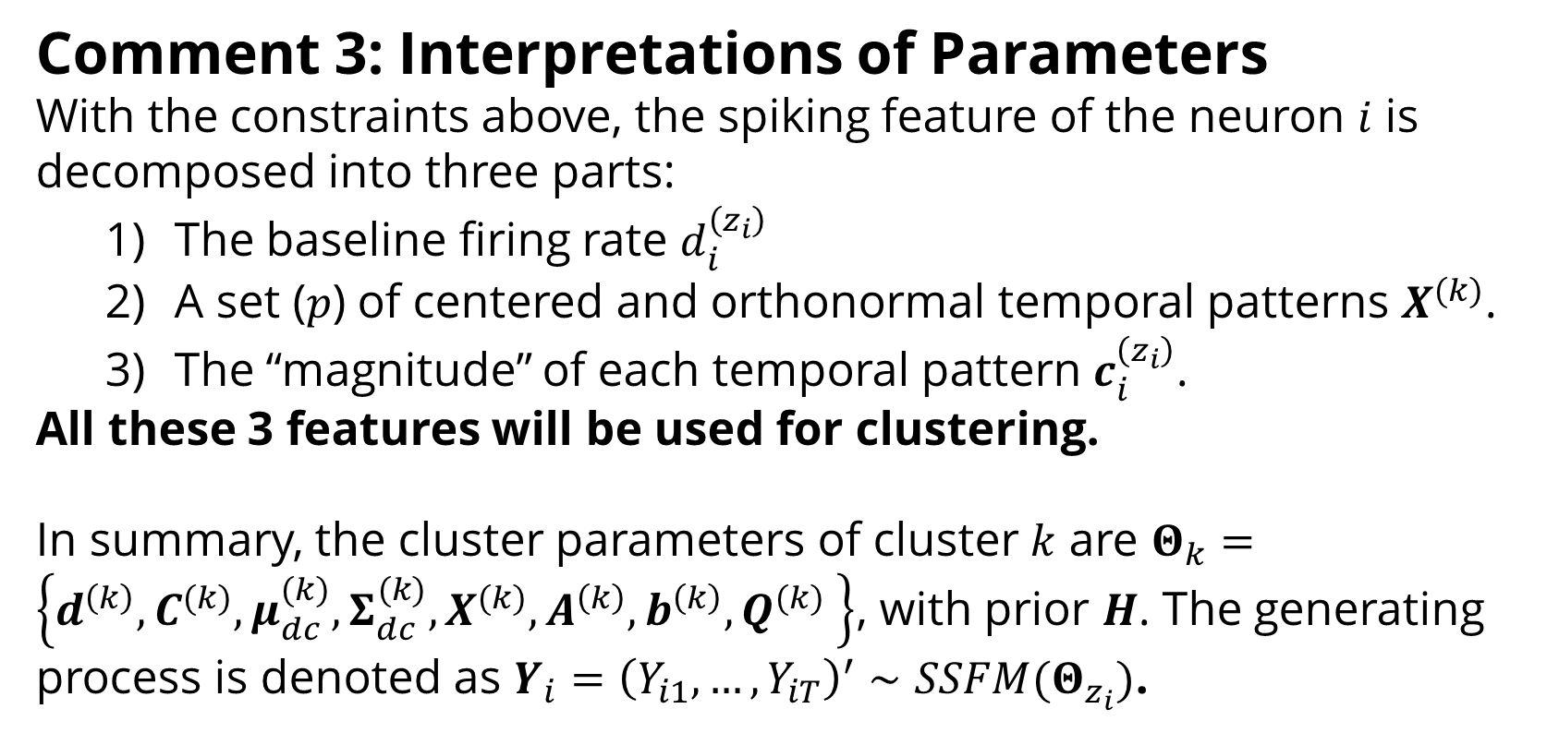
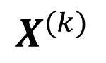
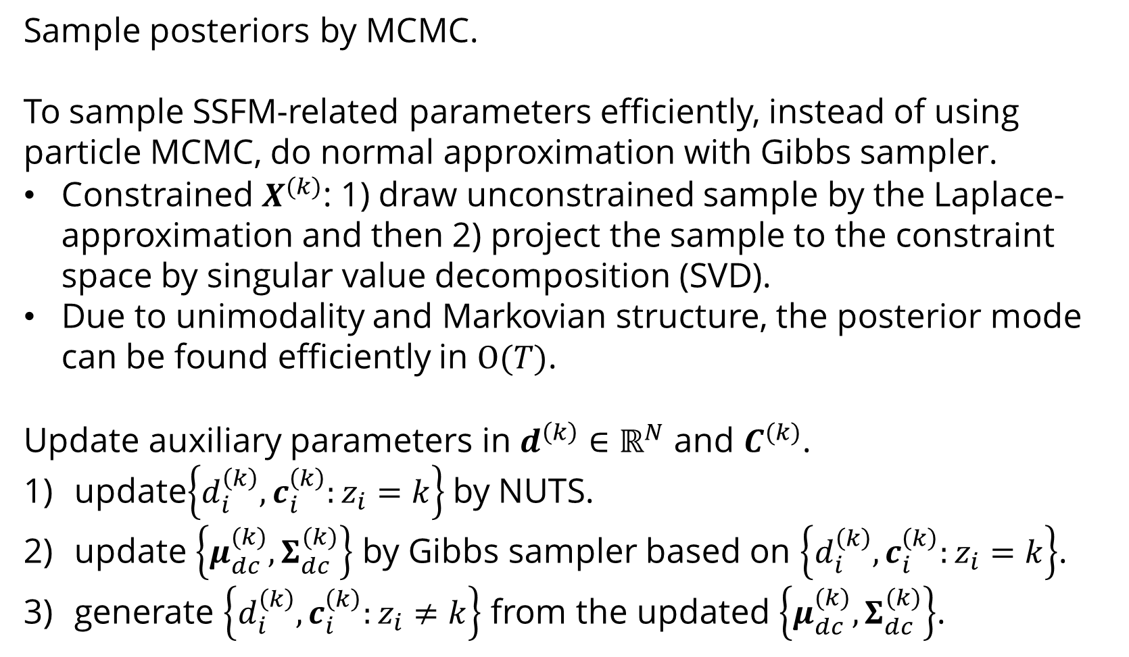
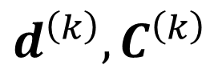
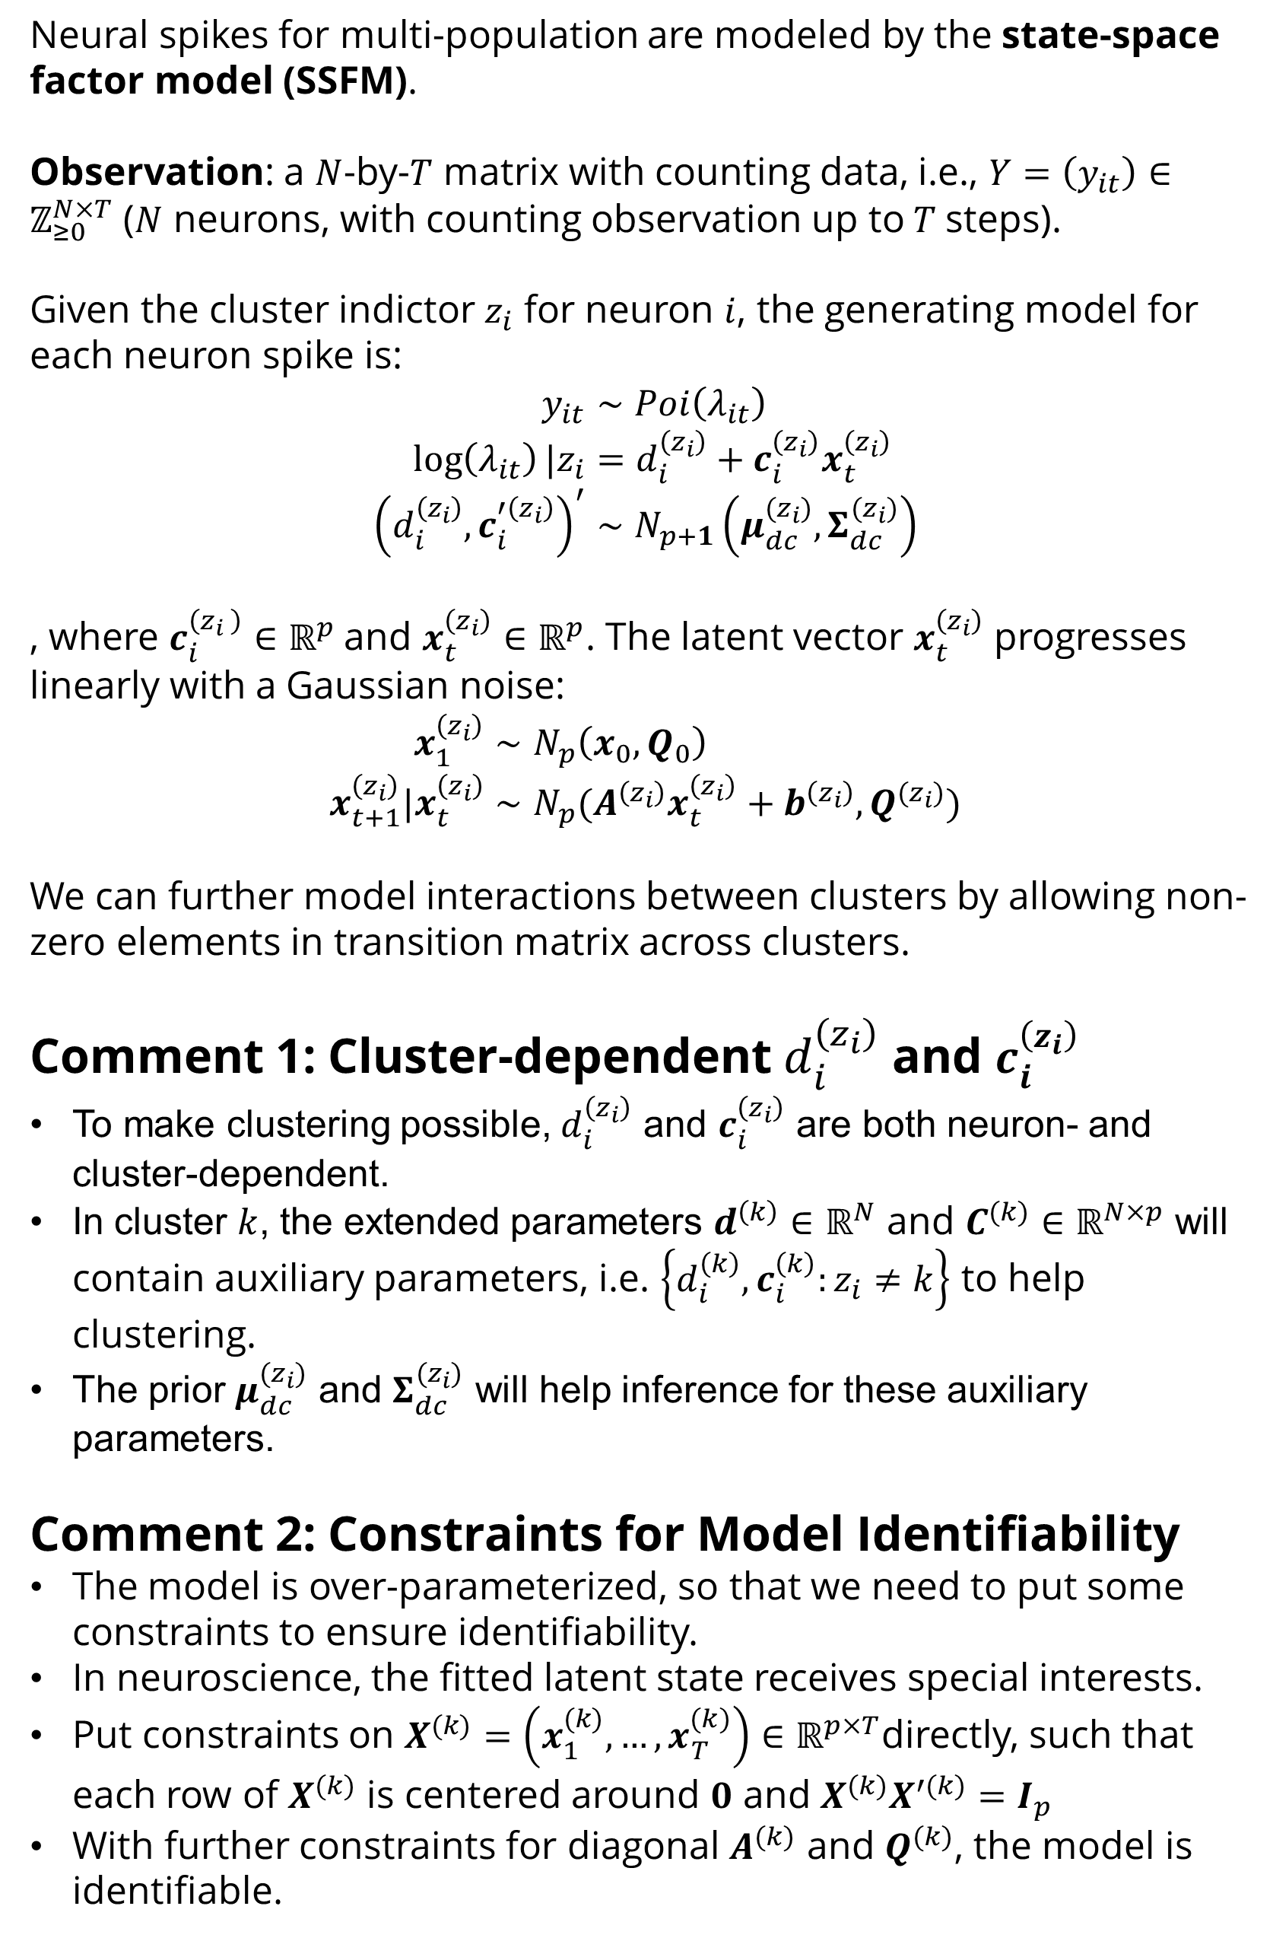
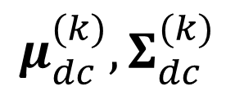
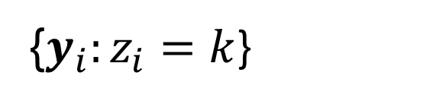
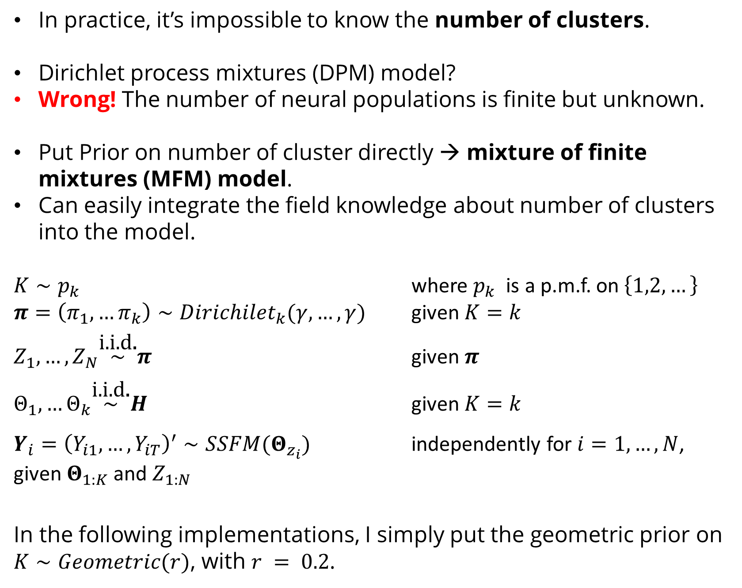
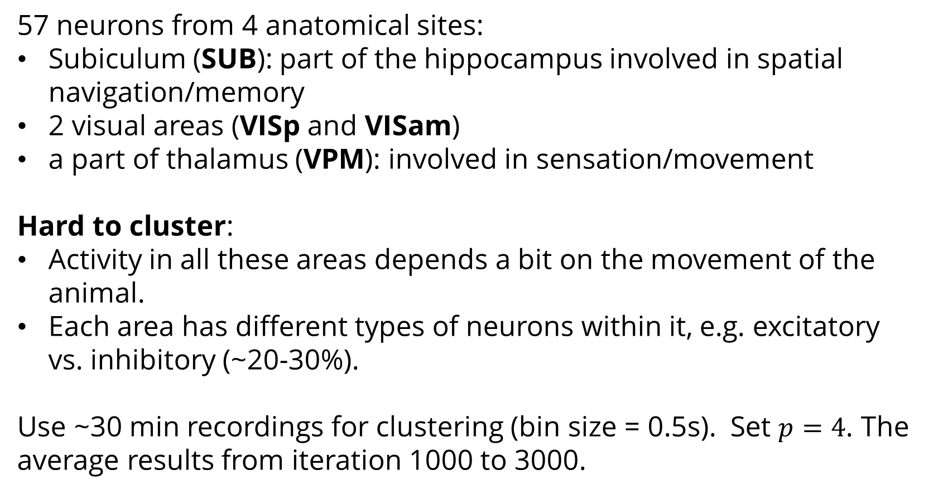
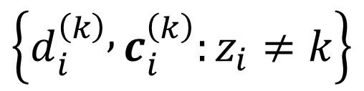

Clustering Neural Populations by State-space Factor Models
Ganchao Wei
University of Connecticut, Department of Statistics
Introduction
Comment 3: Interpretations of Parameters
With the constraints above, the spiking feature of the neuron $i$ is decomposed into three parts:
The baseline firing rate $d_{i}^{\left(z_{i}\right)}$
A set ($p$) of centered and orthonormal temporal patterns $X^{(k)}$.
The “magnitude” of each temporal pattern $c_{i}^{\left(z_{i}\right)}$.
All these 3 features will be used for clustering.
In summary, the cluster parameters of cluster $k$ are $Θ_{k}=\left\{d^{\left(k\right)},C^{(k)},μ_{dc}^{(k)},Σ_{dc}^{(k)},X^{(k)},A^{\left(k\right)},b^{\left(k\right)}, Q^{(k)} \right\}$, with prior $H$. The generating process is denoted as $Y_{i}={\left(Y_{i1},…,Y_{iT}\right)}^{′}∼SSFM(Θ_{z_{i}})$.
Simulations
Simulation 3: A More Challenging Setting
30 neurons in each cluster. In each cluster, some neurons (left panel: tops within each cluster) have weak signals (hard to cluster).
High-density silicon probes and large-scale calcium imaging methods allow neuroscientists to study neurons in the multi-population level.
We are mostly interested in time-varying relationships within and between neural populations, which can usually be captured by low-dimensional latent state vectors. Both AR(1) and Gaussian process (GP) are widely used models for latent vectors.
However, defining the populations is usually difficult. Routinely, we do distance-based clustering at first. If not perfectly accurate → bias the latent structures.
Use the state-space factor model (SSFM) to do clustering, which let the latent structure help with clustering and vice versa.
This method can be used to cluster general multiple time series data, while extracting potential low-dimensional structures at the same time.
Simulation 1: Neurons with Known Labels
3 clusters, 10 neuron in each cluster. The dimension of latent vectors is $p=2$ and recording length is $T=1000$. Run MCMC for 10,000 iterations. Some trace plots:
The averages of fitted mean firing rate and latent sate, from iteration 1000 to 10,000.
Simulation 2: Neurons with Unknown Labels
The same settings as simulation 1 but with unknown labels. The trace of clustering index for each neuron in 1000 iterations.
Models for Clustering: MFM
In practice, it’s impossible to know the number of clusters.
Dirichlet process mixtures (DPM) model?
Wrong! The number of neural populations is finite but unknown.
Put Prior on number of cluster directly → mixture of finite mixtures (MFM) model.
Can easily integrate the field knowledge about number of clusters into the model.
$K∼p_{k}$ where $p_{k}$ is a p.m.f. on $\left\{1,2,…\right\}$
$π=\left(π_{1},…π_{k}\right)∼Dirichilet_{k}(γ,…,γ)$ given $K=k$
$Z_{1},…,Z_{N}\overset{\text{i}\text{.}\text{i}\text{.}\text{d}\text{.}}{\sim }π$ given $π$
$Θ_{1},…Θ_{k}\overset{\text{i}\text{.}\text{i}\text{.}\text{d}\text{.}}{\sim }H$ given $K=k$
$Y_{i}={\left(Y_{i1},…,Y_{iT}\right)}^{′}∼SSFM(Θ_{z_{i}})$ independently for $i=1,…,N$, given $Θ_{1:K}$ and $Z_{1:N}$
In the following implementations, I simply put the geometric prior on $K∼Geometric(r)$, with $r = 0.2$.
Application
57 neurons from 4 anatomical sites:
Subiculum (SUB): part of the hippocampus involved in spatial navigation/memory
2 visual areas (VISp and VISam)
a part of thalamus (VPM): involved in sensation/movement
Hard to cluster:
Activity in all these areas depends a bit on the movement of the animal.
Each area has different types of neurons within it, e.g. excitatory vs. inhibitory (~20-30%).
Use ~30 min recordings for clustering (bin size = 0.5s). Set $p=4$. The average results from iteration 1000 to 3000.
Models for Neural Population: SSFM
Neural spikes for multi-population are modeled by the state-space factor model (SSFM).
Observation: a $N$-by-$T$ matrix with counting data, i.e., $Y=\left(y_{it}\right)∈ℤ_{≥0}^{N×T}$ ($N$ neurons, with counting observation up to$T$steps).
Given the cluster indictor $z_{i}$ for neuron $i$, the generating model for each neuron spike is:
$$y_{it}∼Poi\left(λ_{it}\right) \\ \log\left(λ_{it}\right)|z_{i}=d_{i}^{\left(z_{i}\right)}+c_{i}^{\left(z_{i}\right)}x_{t}^{\left(z_{i}\right)} \\ {\left(d_{i}^{\left(z_{i}\right)},c_{i}^{′\left(z_{i}\right)}\right)}^{′}∼N_{p+1}\left(μ_{dc}^{(z_{i})}, Σ_{dc}^{(z_{i})}\right)$$
, where $c_{i}^{\left(z_{i} \right)}∈ℝ^{p}$and $x_{t}^{\left(z_{i}\right)}∈ℝ^{p}$. The latent vector $x_{t}^{\left(z_{i}\right)}$ progresses linearly with a Gaussian noise:
$$x_{1}^{\left(z_{i}\right)}∼N_{p}\left(x_{0},Q_{0}\right) \\ x_{t+1}^{\left(z_{i}\right)}|x_{t}^{\left(z_{i}\right)}∼N_{p}(A^{\left(z_{i}\right)}x_{t}^{\left(z_{i}\right)}+b^{\left(z_{i}\right)}, Q^{(z_{i})})$$
We can further model interactions between clusters by allowing non-zero elements in transition matrix across clusters.
Comment 1: Cluster-dependent $d_{i}^{\left(z_{i}\right)}$ and $c_{i}^{\left(z_{i}\right)}$
To make clustering possible, $d_{i}^{\left(z_{i}\right)}$ and $c_{i}^{\left(z_{i}\right)}$ are both neuron- and cluster-dependent.
In cluster $k$, the extended parameters $d^{\left(k\right)}∈ℝ^{N}$ and $C^{(k)}∈ℝ^{N×p}$ will contain auxiliary parameters, i.e. $\left\{d_{i}^{\left(k\right)},c_{i}^{\left(k\right)}:z_{i}≠k\right\}$ to help clustering.
The prior $μ_{dc}^{(z_{i})}$ and $Σ_{dc}^{(z_{i})}$ will help inference for these auxiliary parameters.
Comment 2: Constraints for Model Identifiability
The model is over-parameterized, so that we need to put some constraints to ensure identifiability.
In neuroscience, the fitted latent state receives special interests.
Put constraints on $X^{(k)}=\left(x_{1}^{(k)},…,x_{T}^{(k)}\right)∈ℝ^{p×T}$directly, such that each row of $X^{(k)}$ is centered around $0$ and $X^{(k)}X^{′(k)}=I_{p}$
With further constraints for diagonal $A^{(k)}$ and $Q^{(k)}$, the model is identifiable.
Inference
Sample posteriors by MCMC.
To sample SSFM-related parameters efficiently, instead of using particle MCMC, do normal approximation with Gibbs sampler.
Constrained $X^{(k)}$: 1) draw unconstrained sample by the Laplace-approximation and then 2) project the sample to the constraint space by singular value decomposition (SVD).
Due to unimodality and Markovian structure, the posterior mode can be found efficiently in $Ο(T)$.
Update auxiliary parameters in $d^{\left(k\right)}∈ℝ^{N}$ and $C^{(k)}$.
update$\left\{d_{i}^{\left(k\right)},c_{i}^{\left(k\right)}:z_{i}=k\right\}$by NUTS.
update $\left\{μ_{dc}^{(k)},Σ_{dc}^{(k)}\right\}$ by Gibbs sampler based on $\left\{d_{i}^{\left(k\right)},c_{i}^{\left(k\right)}:z_{i}=k\right\}$.
generate $\left\{d_{i}^{\left(k\right)},c_{i}^{\left(k\right)}:z_{i}≠k\right\}$ from the updated $\left\{μ_{dc}^{(k)},Σ_{dc}^{(k)}\right\}$.
Acknowledgements
I thank my advisors Dr. Ian H. Stevenson and Dr. Xiaojing Wang for detailed and constructive discussions, comments and suggestions. Thank the Allen Institute for sharing the neuropixels data.
References
{$y_{i}:z_{i}=k$}
$$X^{(k)}$$
Macke, J. H. et al. Empirical models of spiking in neural populations. Adv. Neural Inf. Process. Syst. 24, (2011).
Miller, J. W. & Harrison, M. T. Mixture models with a prior on the number of components. J. Am. Stat. Assoc. 113, 340 (2018).
inference: step 2
inference: step 1
$$μ_{dc}^{(k)},Σ_{dc}^{(k)}$$
generating
process
$\left\{d_{i}^{\left(k\right)},c_{i}^{\left(k\right)}:z_{i}=k\right\}$
$$d^{\left(k\right)},C^{\left(k\right)}$$
$$\left\{d_{i}^{\left(k\right)} , c_{i}^{\left(k\right)}:z_{i}≠k\right\}$$
inference: step 3

